Slide 1

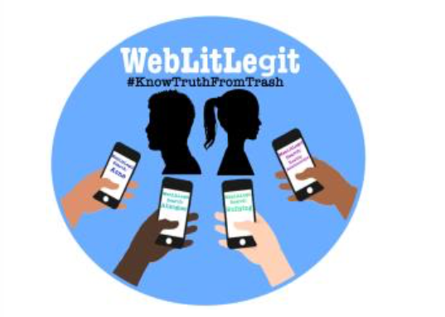
Is your WebLitLegit?
Finding Safe & Good Health Information on the Internet

Slide 2
What do YOU use to surf the web?
Cell Phone?
Computer or Tablet?
Google?
Social Media?

Slide 3
What are some health topics you have searched?
Why is my body changing?
What is COVID-19?
How can I stop bullies?
What are healthy foods to eat?

Slide 4
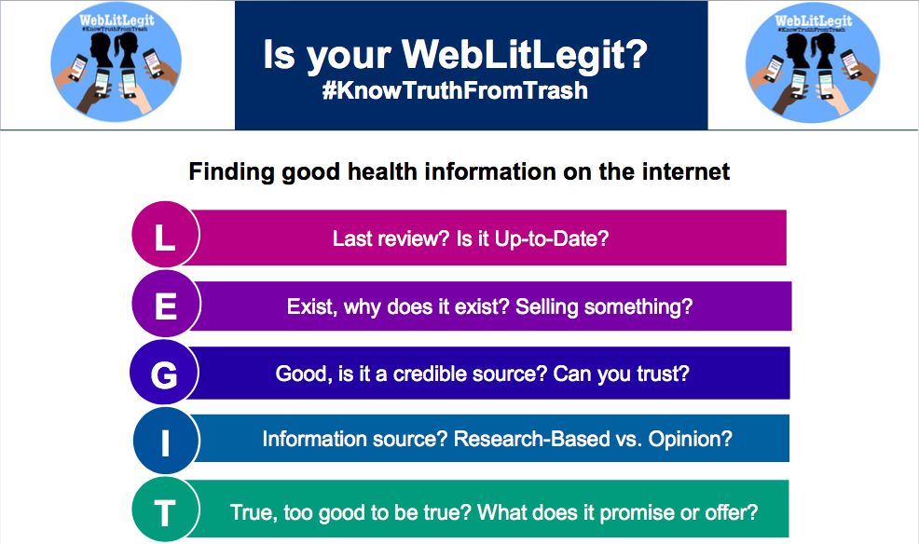

Slide 5
Websites that are LEGIT!!!
Look for these at the end of your website links!
.org
.gov
.edu
https://medlineplus.gov/childrenandteenagers.html
http://kidshealth.org
https://www.cdc.gov/DiseasesConditions/
https://www.stopbullying.gov/
https://www.plannedparenthood.org/learn/teens

Slide 6
Let’s Break It Down:
L.E.G.I.T.
Here are some examples we can try together!
Notes:
Facilitator instructions:
For each website have participants use their smartphones to capture the QR code and visit the website themselves
Ask participants the questions listed on the slide about each website
After going through the questions summarize the website that was visited as a group- is it reliable? Why or why not?

Slide 7
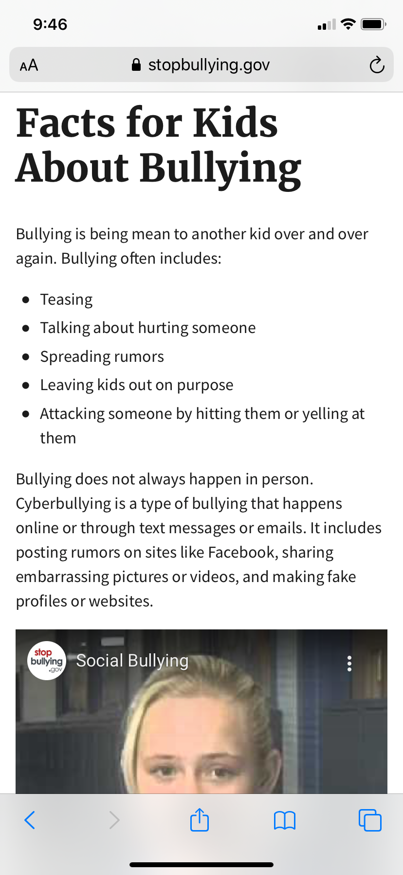

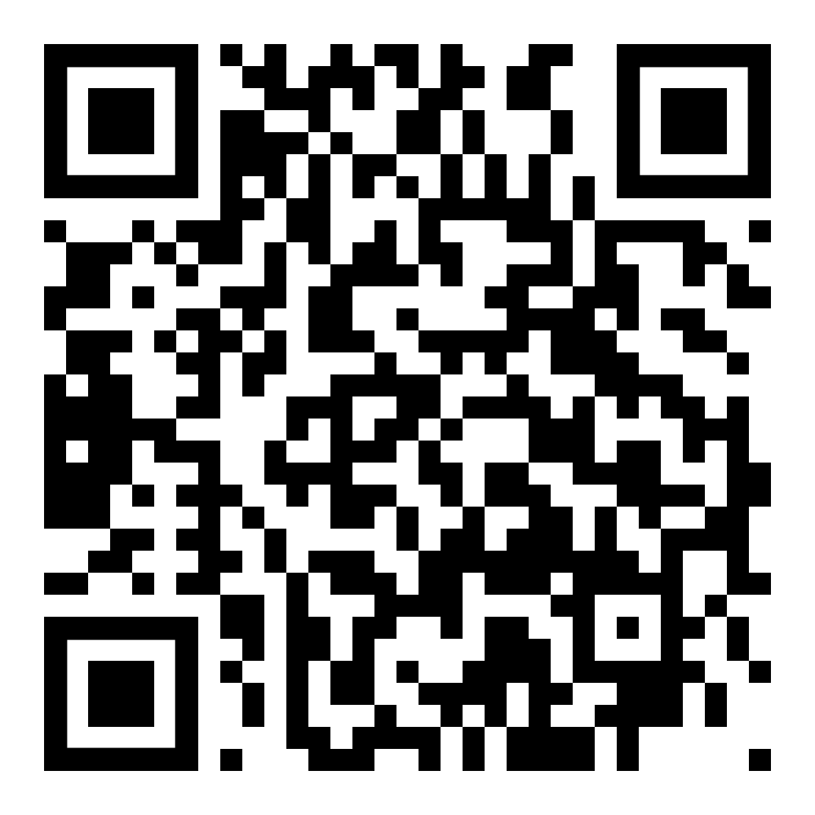
When was this website uploaded or reviewed?
Has it been updated in the last 3 years?
Facts about Bullying
Notes:
Script:
Q: when was this website uploaded or last reviewed?
A: September 8, 2017
Q: Has it been updated in the last 3 years?
A: yes- 2017
Truth vs. Trash?
Truth!
L: last reviewed at the dates mentioned above
E: this website exists to provide unopinionated facts for children about bullying. There are not ads or other information on the website that would indicate that they are trying to sell you something.
G: If you scroll to the bottom you can see that the website is managed by the U.S. Department of Health and Human Services. In addition, it is a “.gov” website address.
I: the information is provided by the US department of Health and Human services, a trusted government resource that uses research to base their information on.
T: There are no offers or promises being made on this website to its users. Its sole purpose appears to be to provide information.

Slide 8
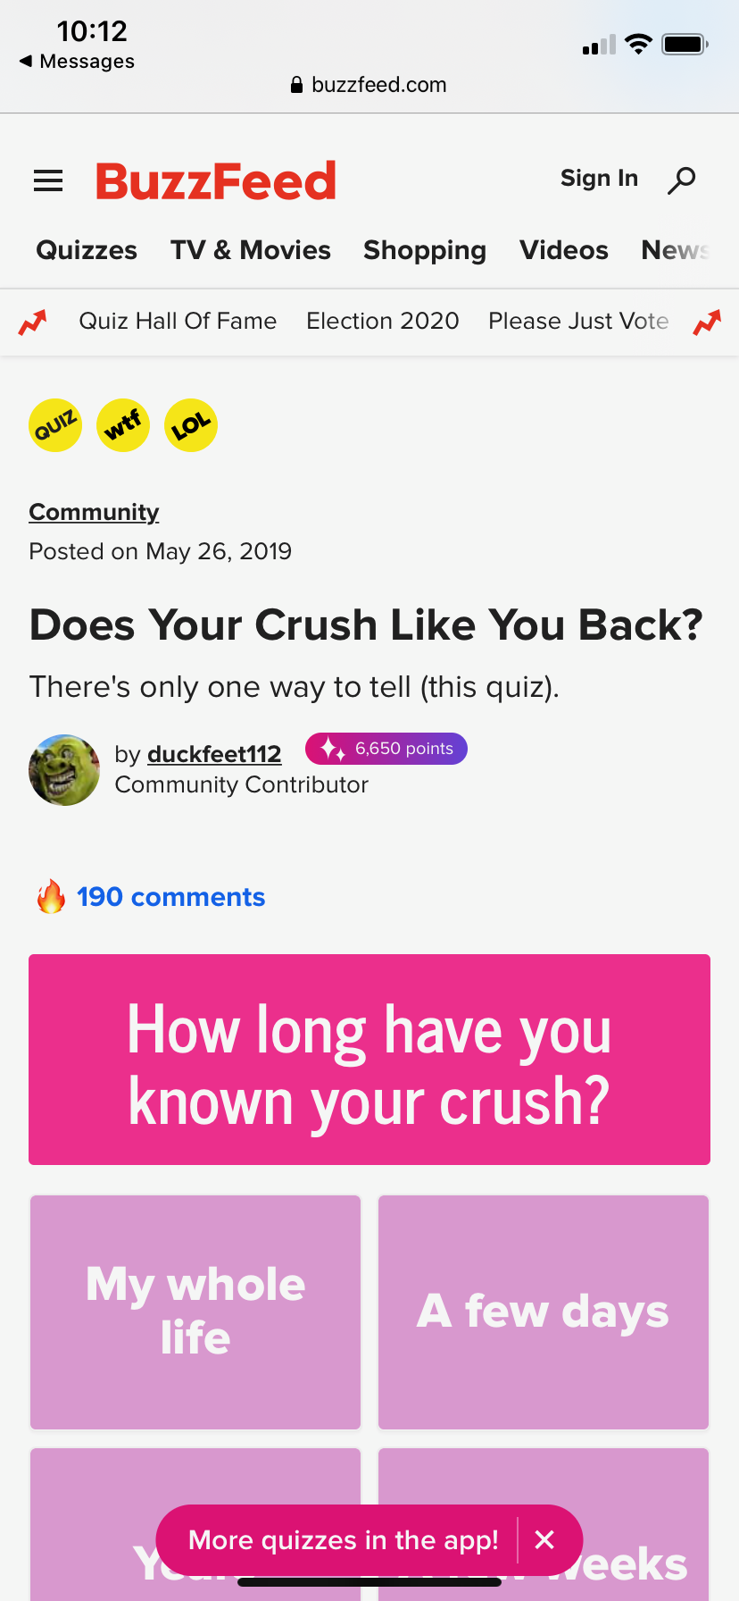

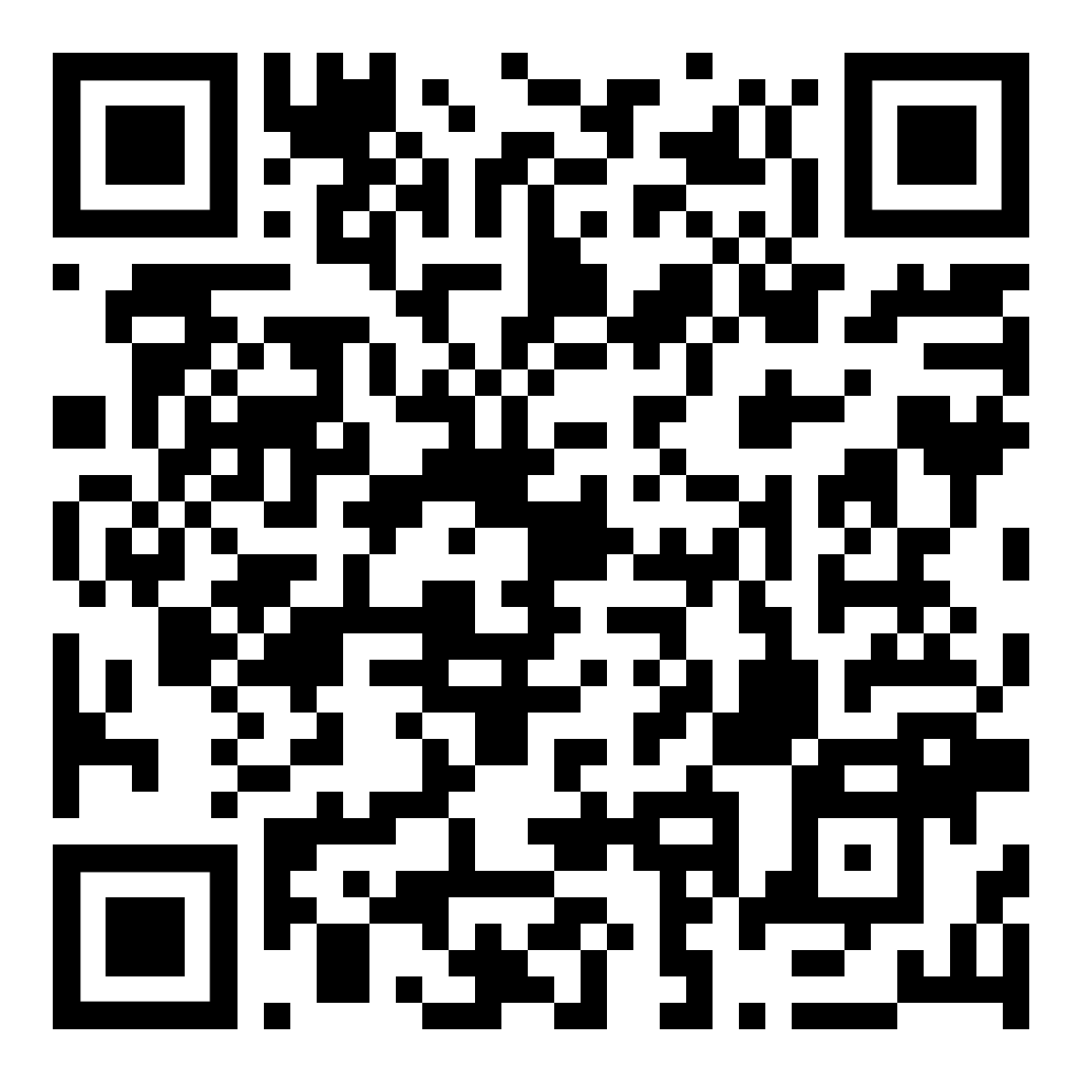
Why does the site exist? Is it selling something or a scam? What do they want from you?
Quiz: Does Your Crush Like You Back?
Notes:
Q: Why does the site exist?
A: To get users to interact and visit their page often because there are many adds selling items or services and they sell your private and usage information.
Q: Is it selling something or a scam?
A: Yes, they have many advertisements that if you click or purchase from the ads, the website owners make money as well as by selling your personal data and related use of their services.
Q: What do they want from you?
A: They want you to become a member of their community by providing your email address thus, receive newsletters & quizzes to engage you for ongoing exposure to their ads.
Truth vs Trash:
Trash!
L: It says that it was posted on May 26,2019. While this is considered “up to date” there is nowhere on this site that it was reviewed by other professionals.
E: Covered above.
G: First, this website is a “.com” website, not a .org/.gov so it may not be part of a credible organization. In addition, if you continue to search on BuzzFeed you will notice that a lot of the content on this website is opinion based quizzes and articles created by its users- who are not confirmed professionals in their field.
I: The site is opinion-based with much of the content being created by users. Nowhere on the website to you see any research articles referenced.
T: It is too good to be true! By selecting your answers to the quiz it gives you results about your crush without knowing the quiz taker or using any factual information. The purpose of it is to create a fun quiz to engage users to visit the site, purchase from the adds and sell your information. In addition, it “provides” non-credible relationship advice.

Slide 9
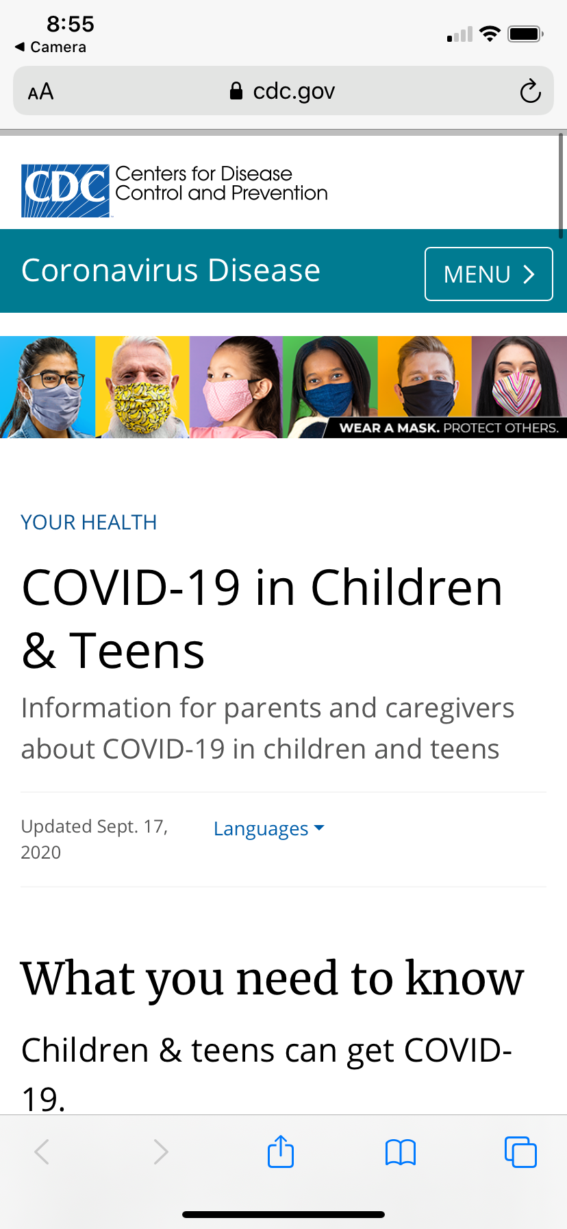

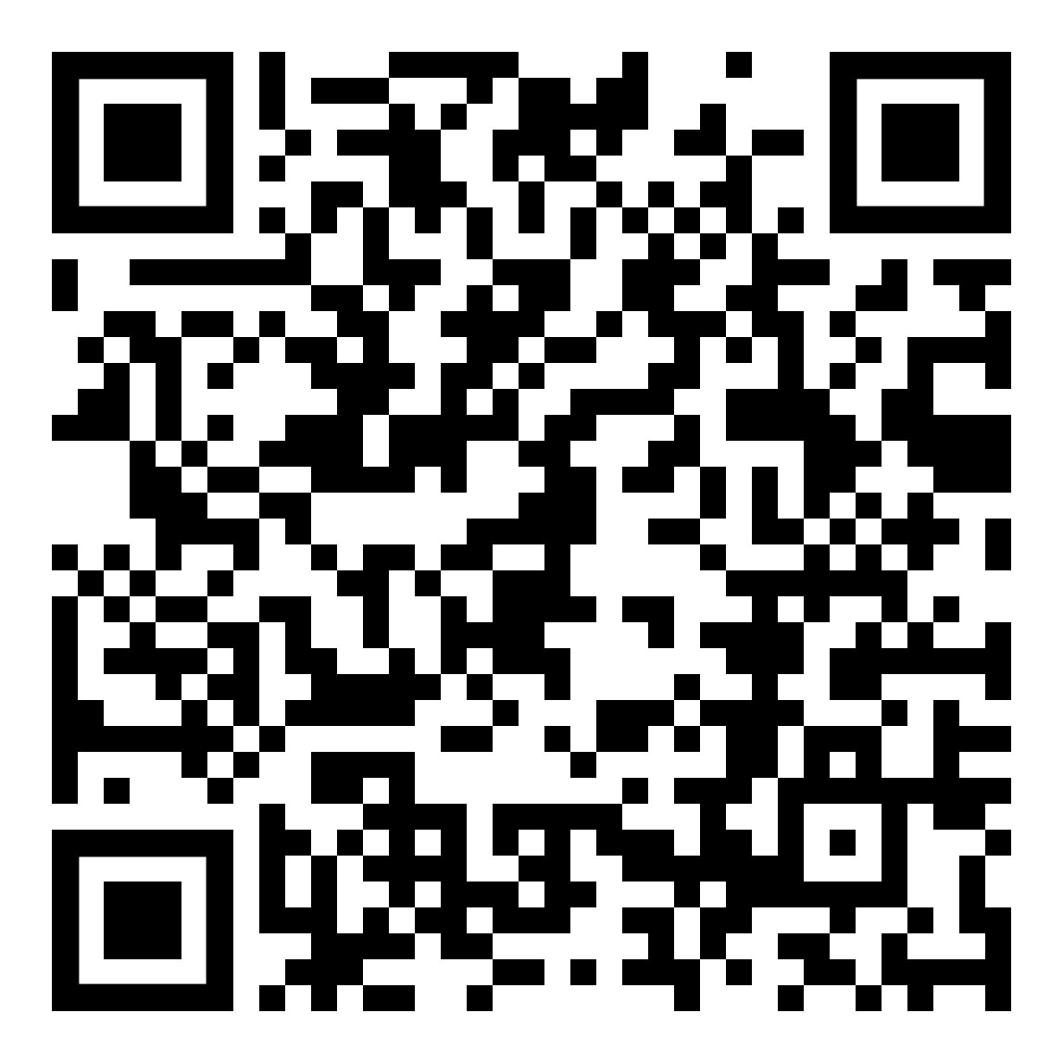
Where does the information come from?
Is it based on research?
COVID-19 in Children & Teens
Notes:
Q: Where does the information come from
A: Center for Disease Control and Prevention- a trusted health source used frequently by healthcare providers
Q: is it based on research?
A: Yes, if you click on the “more” tab at the top a dropdown menu will appear that will have a page for “Science and Research” after following that you can see the research articles the CDC reviews and publishes.
Truth vs Trash?
Truth!
Users might want to discuss the information on this page with their parents!
L: At the top of the page under the title you can see that the page was last updated September 17 2020.
E: This site exists to provide factual up to date information about covid-19 for the public. There are not any ads on the website. So, it does not appear like they are selling something to you. In addition, it is a “.gov” website.
G: See above.
I: The information on this site is science based. At the bottom of the page you can see the source that the information came from next to “Content Source” in the bottom right hand corner.
T: There are no promises or offers. The site provides only credible information.

Slide 10
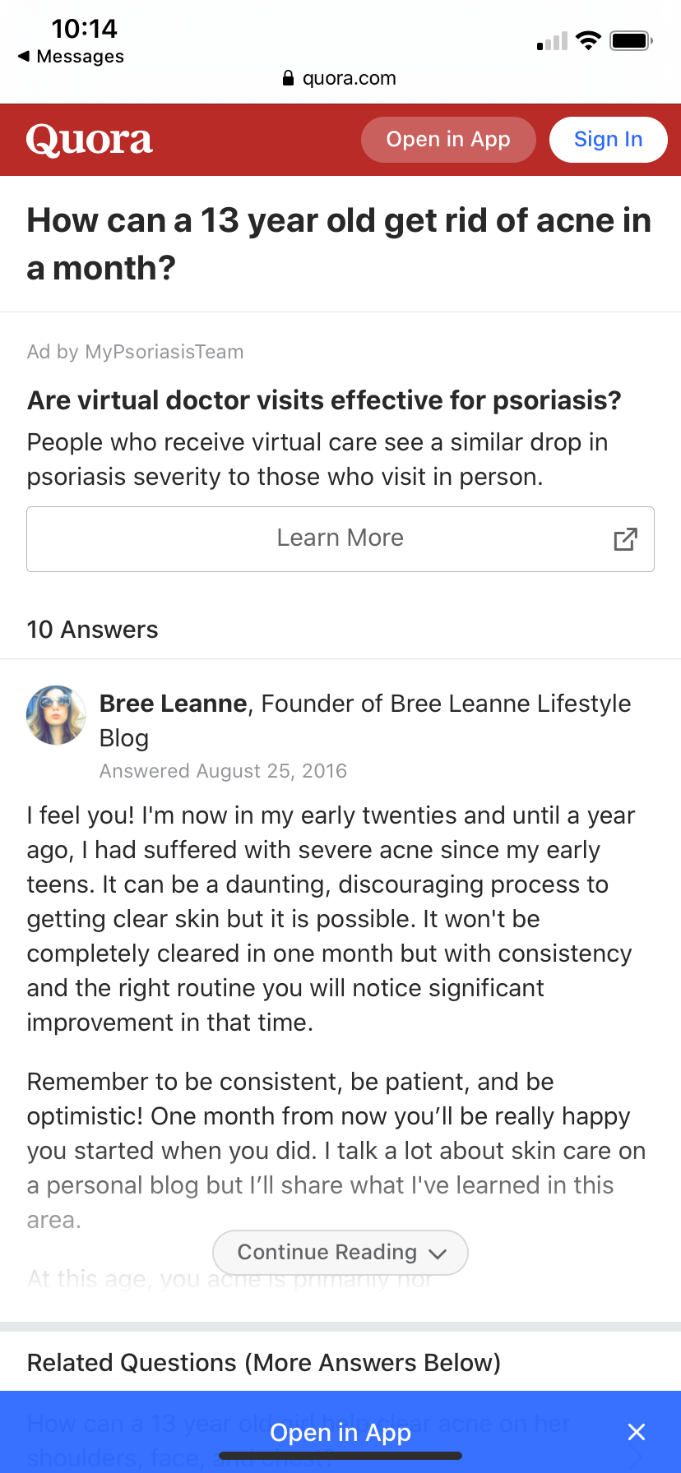

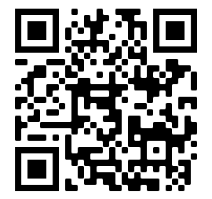
Is it opinion-based or science-based?
How can a 13 year old get rid of acne in a month?
Notes:
Change this to a kid speaking
Q: Is it opinion-based or science based?
A: Opinion-based! You can see the people responding to the question in a answer format. “Bree Leanne” describes herself as “founder of Bree Leanne Lifestyle blog” she does not say she is a doctor. There are also 10 other answers of other people sharing their opinions about this question.
Truth vs. Trash:
Trash!
L: The answer to this question is from 2016- 4 years ago. There is no where on the site that says that these answers were reviewed by anyone.
E: This website exists for people to ask questions that they have and for random people that are on the website to answer. It is for the public not for doctors or people in healthcare. This website also is a “.com” website.
G: You do not see anywhere on the website that they get their information from science or research.
I: See above
T: If you keep reading some of the answers to the questions, some people tell the user to visit their website or profile to see how to get rid of acne scars which may be too good to be true or trying to sell something.

Slide 11
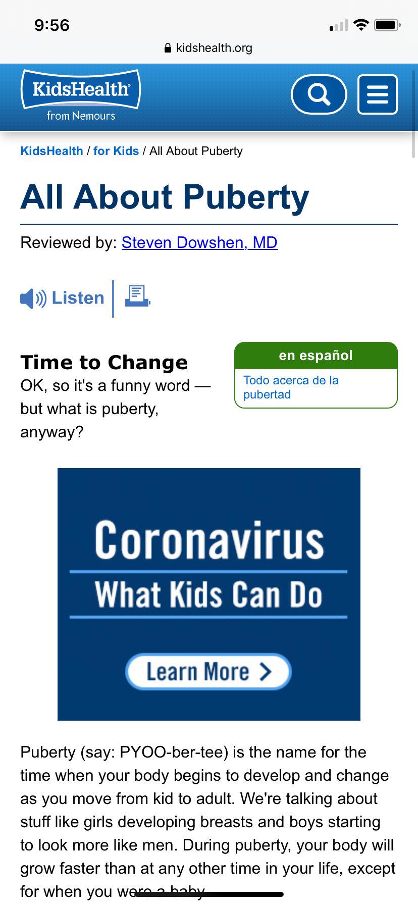

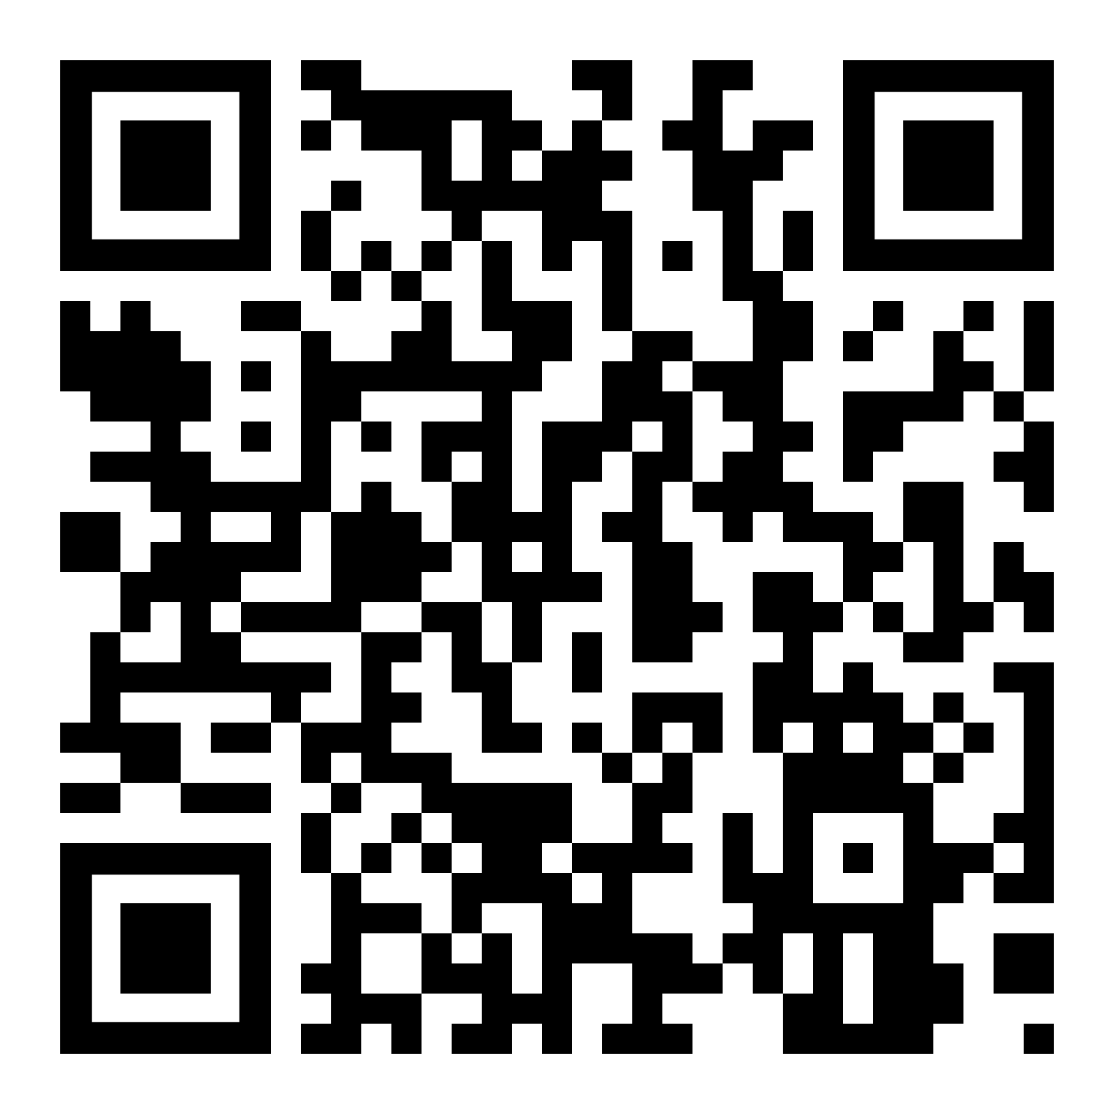
What is the site promising or offering? Do the claims seem too good to be true?
All About Puberty
Notes:
Q: What is the site promising or offering?
A: There is no material being promised or offered from this site. They are providing information alone
Q: Do the claims seem too good to be true?
A: There are no promises being made in this article. It is only for people to learn from. Also the article says it was reviewed by a MD- which is a medical doctor.
Truth vs. Trash:
Truth!
L: Last reviewed in October 2015- this is not within the last 3 years. However, it does at least show that it was reviewed by a doctor (MD stands for medical doctor)
E: There is nothing being sold to people that visit the website. You can see at the bottom of the page the website says: “Note: All information on KidsHealth® is for educational purposes only. For specific medical advice, diagnoses, and treatment, consult your doctor.” They say the purpose of their website is only for education. This is also a “.org” website.
G: If your parents want to look to make sure that this site has good information they can scroll to the bottom and click “editorial policy” and it will say how KidsHealth® gets the information for this website.
I: The information for this website is science-based.
T: See above

Slide 12
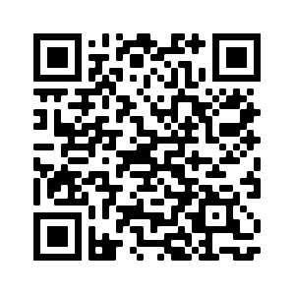
So is this Website LEGIT?
Lets review all 5 letters!
Acne - Selfcare
Notes:
L:
E:
G:
I:
T:

Slide 13
Why is Web Literacy important to YOU?
Tell us what you think!

Slide 14
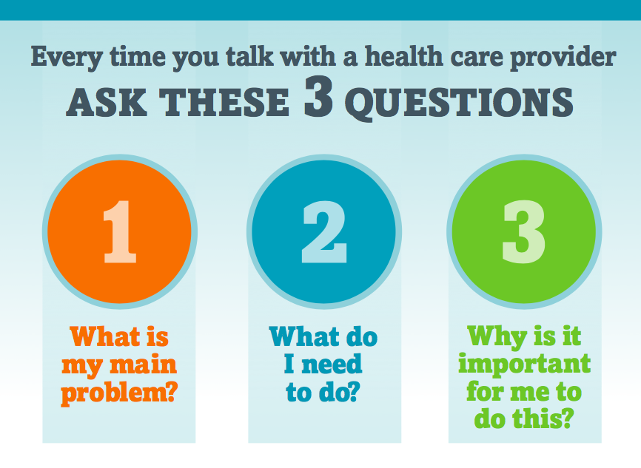
Notes:
What is my main problem?
When to ask questions
You can ask questions when:
You see a doctor, nurse, pharmacist, or other health care provider.
You prepare for a medical test or procedure.
You get your medicine.
What do I need to do?
What if I ask and still don’t understand?
Let your health care provider know if you still don’t understand what you need.
You might say, “This is new to me. Will you please explain that to me one more time?”
Why is it important for me to do this?
Who needs to ask 3?
Everyone wants help with health information. You are not alone if you find things confusing at times. Asking questions helps you understand how to stay healthy.

Slide 15
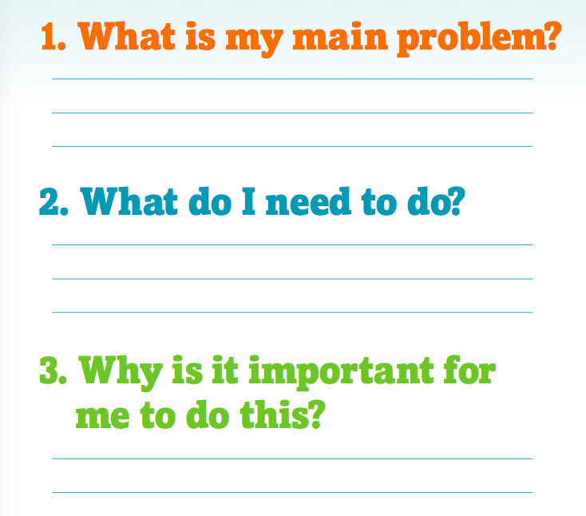
Let’s Practice!

Slide 16

KAHOOT TIME!!
Let’s test your knowledge
KAHOOT

Slide 17
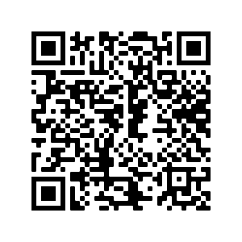
Tell us how we did!
Please complete this evaluation!
Use your QR scanner to scan the code on the right.
This is anonymous - no one will know it was you!!!
Notes:
https://docs.google.com/forms/d/e/1FAIpQLScWWyb3OLtpuAnyaDwY9MQUXC0dvNJoFE3NrPPVu3noqQVKfA/viewform-- link for evaluation form!

Slide 18

This project was supported by the National Network of the Libraries of Medicine under Award Number 1UG4LM012345-01. The content is solely the responsibility of the authors and does not necessarily represent the official views of the National Institutes of Medicine.

